Slide 1
CSC 2224: Parallel Computer Architecture and Programming Main Memory. DRAM.
Prof. Gennady Pekhimenko
University of Toronto
Fall 2022
The content of this lecture is adapted from the slides of
Vivek Seshadri, Donghyuk Lee, Yoongu Kim,
and lectures of Onur Mutlu @ ETH and CMU

Slide 2
Outline
What is DRAM?
DRAM Internal Organization
DRAM Cell
DRAM Array
DRAM Bank
Problems and Solutions
Latency (Tiered-Latency DRAM, HPCA 2013 Adaptive-Latency DRAM, HPCA 2015)
Parallelism (Subarray-level Parallelism, ISCA 2012)

Slide 3
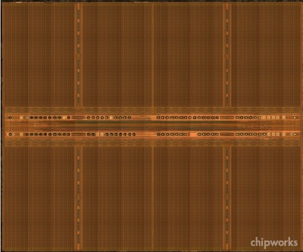
DRAM Bank
How to build a DRAM bank from a DRAM array?

Slide 4
DRAM Bank: Single DRAM Array?
Long bitline
Difficult to sense data in far away cells
Row Decoder
1
0
0
1
1
0
0
1
Row Address
10000+ rows

Slide 5
DRAM Bank: Collection of Arrays
Row Decoder
1
0
0
1
1
0
0
1
Subarray
Row Decoder
Data
Row Address
Column Read/Write

Slide 6
DRAM Operation: Summary
Row Decoder
1
0
0
1
1
0
0
1
Row Decoder
Row m, Col n
1. Enable row m
2. Access col n
3. Close row
m
Row Address
Column Read/Write
m
n

Slide 7
DRAM Chip Hierarchy
Collection of Banks
Row Decoder
1
0
0
1
1
0
0
1
Row Decoder
Row Address
Column Read/Write
Collection of Subarrays

Slide 8
Outline
What is DRAM?
DRAM Internal Organization
Problems and Solutions
Latency (Tiered-Latency DRAM, HPCA 2013; Adaptive-Latency DRAM, HPCA 2015)
Parallelism (Subarray-level Parallelism, ISCA 2012)

Slide 9
Factors That Affect Performance
Latency
How fast can DRAM serve a request?
Parallelism
How many requests can DRAM serve in parallel?

Slide 10
DRAM Chip Hierarchy
Collection of Banks
Row Decoder
Parallelism
1
0
0
1
1
0
0
1
Row Decoder
Latency
Row Address
Column Read/Write
Collection of Subarrays

Slide 11
Outline
What is DRAM?
DRAM Internal Organization
Problems and Solutions
Latency (Tiered-Latency DRAM, HPCA 2013; Adaptive-Latency DRAM, HPCA 2015)
Parallelism (Subarray-level Parallelism, ISCA 2012)

Slide 12
Subarray Size: Rows/Subarray
Number of rows in subarray
Latency
Chip Area

Slide 13
Subarray Size vs. Access Latency
Shorter Bitlines => Faster access
Smaller subarrays => lower access latency

Slide 14
Subarray Size vs. Chip Area
Large Subarray
Smaller Subarrays
Area
Cost
Smaller subarrays => larger chip area

Slide 15
Chip Area vs. Access Latency
32 rows/subarray
Commodity DRAM
(512 rows/subarray)
Why is DRAM so slow?

Slide 16
Chip Area vs. Access Latency
32 rows/subarray
Commodity DRAM
(512 rows/subarray)
?
How to enable low latency without high area overhead?

Slide 17
New Proposal
Low area cost
Large Subarray
Our Proposal
Small Subarray

Slide 18
Tiered-Latency DRAM
- Higher access latency
- Higher energy/access
Far Segment
Near Segment
+ Lower access latency
+ Lower energy/access
Map frequently accessed data to near segment

Slide 19
Results Summary
Commodity DRAM
Tiered-Latency DRAM
12%
23%

Slide 20
Tiered-Latency DRAM: A Low Latency and Low Cost DRAM Architecture
Donghyuk Lee, Yoongu Kim, Vivek Seshadri, Jamie Liu, Lavanya Subramanian, Onur Mutlu
Published in the proceedings of 19th IEEE International Symposium on
High Performance Computer Architecture 2013

Slide 21
DRAM Stores Data as Charge
DRAM cell
Three steps of charge movement
1. Sensing
2. Restore
3. Precharge
Sense amplifier
Notes:
The right figure shows DRAM organization which is consists of DRAM cells and sense-amplifiers.
There are three steps for accessing DRAM.
First, when DRAM selects one of rows in its cell array, the selected cells drive their charge to sense-amplifiers.
Then, sense-amplifiers detect the charge, recognizing data of cells.
We call this operation as sensing.
Second, after sensing data from DRAM cells, sense-amplifiers drive charge to the cells for reconstructing original data.
We call this operation as restore.
Third, after restoring the cell data, DRAM deselects the accessed row and puts the sense-amplifiers to original state for next access.
We call this operation as precharge.
As shown in these three steps, DRAM operation is charge movement between cell and sense-amplifier.

Slide 22
DRAM Charge over Time
cell
cell
Data 1
charge
Sense amplifier
Sense amplifier
Data 0
Timing Parameters
Sensing
Restore
time
In theory
margin
In practice
Why does DRAM need the extra timing margin?
Notes:
Timing parameters exist to ensure sufficient movement of charge.
The figure shows the timeline for accessing DRAM in X-axis and Y-axis shows the charge amount in DRAM cell and sense-amplifier.
When selecting a row of cells, each cell drives their charge toward to the corresponding sense-amplifier.
If driven charge is more than enough to detect the data, the sense-amplifier starts to restore data by driving charge toward the cell.
This restore operation finishes when the cell is fully charged.
Ideally, DRAM timing parameters are just enough for the sufficient movement of charge.
However, in practice, there are large margin in DRAM timing parameters.
Why are these margin required?

Slide 23
Two Reasons for Timing Margin
1. Process Variation
DRAM cells are not equal
Leads to extra timing margin for cell that can store small amount of charge
1. Process Variation
DRAM cells are not equal
Leads to extra timing margin for cells that can store large amount of charge
1. Process Variation
DRAM cells are not equal
Leads to extra timing margin for cell that can store small amount of charge;
2. Temperature Dependence
DRAM leaks more charge at higher temperature
Leads to extra timing margin when operating at low temperature
Notes:
There are two reasons for the margin in DRAM timing parameters.
First is process variation and second is temperature dependence.
Let me introduce the first factor, process variation.

Slide 24
DRAM Cells are Not Equal
Ideal
Real
Smallest cell
Largest cell
Same size →
Different size →
Large variation in cell size →
Same charge →
Different charge →
Large variation in charge →
Same latency
Different latency
Large variation in access latency
Notes:
Ideally, DRAM would have uniform cells which have same size, thereby having same access latency.
Unfortunately, due to process variation, each cell has different size, thereby having different access latency.
Therefore, DRAM shows large variation in both charge amount in its cell and access latency to its cell.

Slide 25
Two Reasons for Timing Margin
1. Process Variation
DRAM cells are not equal
Leads to extra timing margin for cells that can store large amount of charge
2. Temperature Dependence
DRAM leaks more charge at higher temperature
Leads to extra timing margin when operating at low temperature
2. Temperature Dependence
DRAM leaks more charge at higher temperature
Leads to extra timing margin when operating at low temperature
2. Temperature Dependence
DRAM leaks more charge at higher temperature
Leads to extra timing margin when operating at low temperature
Notes:
There are two reasons for the margin in DRAM timing parameters.
First is process variation and second is temperature dependence.
Let me introduce the first factor, process variation.

Slide 26
Charge Leakage Temperature
Room Temp.
Hot Temp. (85°C)
Cells store small charge at high temperature
and large charge at low temperature
→ Large variation in access latency
Small leakage
Large leakage
Notes:
DRAM leakage increases the variation.
DRAM loses their charge over time and loses more charge at higher temperature.
Therefore, DRAM cell has smallest charge when operating at hot temperature, for example 85C which is the highest temperature guaranteed by DRAM standard.
This temperature dependence increases the variation in DRAM cell charge.

Slide 27
DRAM Timing Parameters
DRAM timing parameters are dictated by the worst case
The smallest cell with the smallest charge in all DRAM products
Operating at the highest temperature
Large timing margin for the common case
Can lower latency for the common case

Slide 28
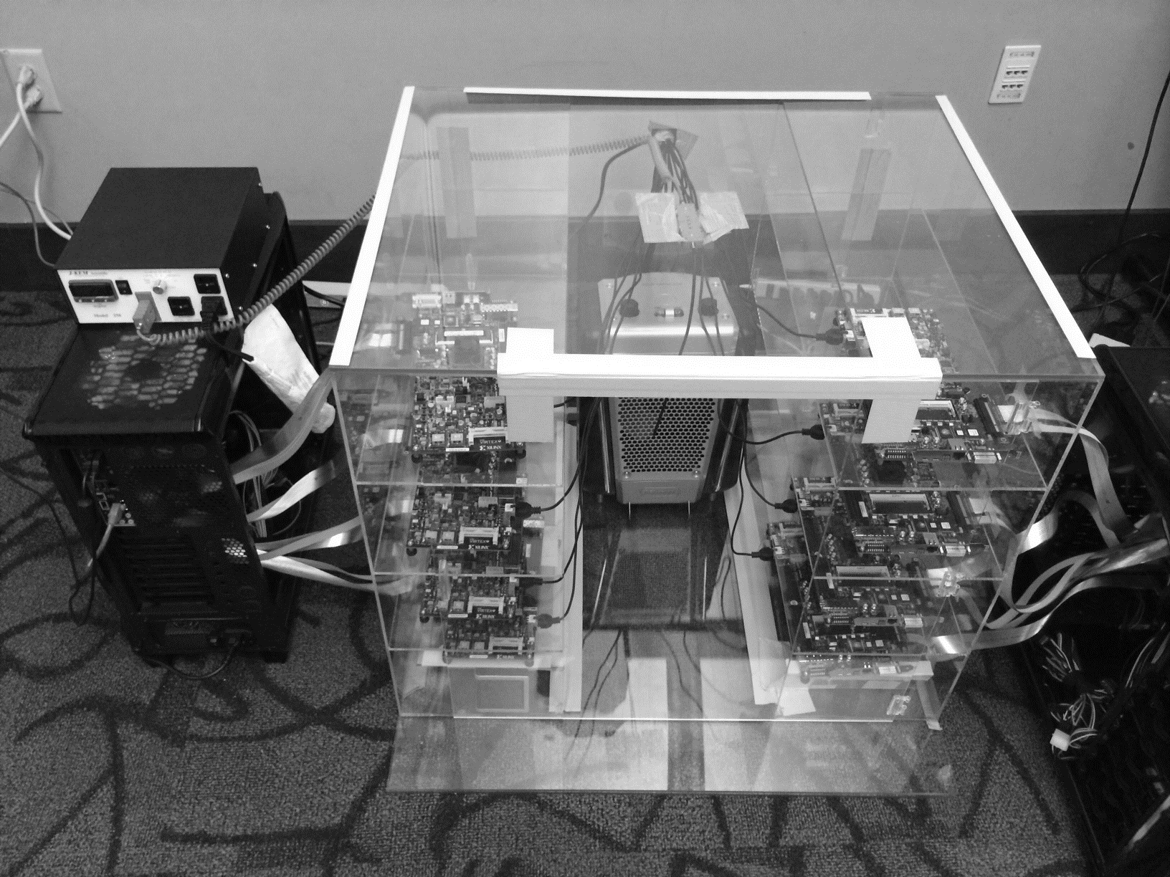
DRAM Testing Infrastructure
Temperature
Controller
FPGAs
Heater
FPGAs
PC
Notes:
This is the photo of our infrastructure, that we built mostly from scratch.
For higher throughput, we employ eight FPGAs, all of which are enclosed in thermally-regulated environment.

Slide 29
Obs 1. Faster Sensing
Typical DIMM at
Low Temperature
Timing
(tRCD)
17% ↓
No Errors
115 DIMM
characterization
More charge
Strong charge
flow
Faster sensing
Typical DIMM at Low Temperature
→ More charge → Faster sensing
Notes:
First step in DRAM operation is sensing.
In typical case, there are more charge in DRAM cell compared to the worst case.
The excessive charge enables stronger charge drive to sense-amplifier.
Then, sense-amplifier can detect data of DRAM cell fast, thereby complete sensing operation fast.
In our DRAM latency profiling results of 115 DRAM modules,
we observe that 17% potential reduction for the corresponding timing parameters of sensing.
As a result, more charge in typical cases lead to fast sensing.

Slide 30
Obs 2. Reducing Restore Time
Typical DIMM at
Low Temperature
115 DIMM
characterization
Read (tRAS)
37% ↓
Write (tWR)
54% ↓
No Errors
Larger cell &
Less leakage ➔
Extra charge
No need to fully
restore charge
Typical DIMM at lower temperature
→ More charge → Restore time reduction
Notes:
Second step in DRAM operation is restore.
Due to larger size and less leakage, typical DRAM cells have more charge than the worst cell.
Even though typical DRAM does not restore the excessive charge during restore operation,
eventually the typical cell has more charge than the worst case cell, guaranteeing reliable operations.
By reducing this restore time in DRAM read/write, our DRAM latency characterization shows significant potential to reduce corresponding timing parameters. For example, 37% for read and 54% for write.
As a result, more charge in typical cases enables restore time reduction.

Slide 31
Obs 3. Reducing Precharge Time
Typical DIMM at
Low Temperature
Sensing
Half
Precharge
Empty (0V)
Full (Vdd)
Bitline
Sense amplifier
Precharge ?
– Setting bitline to half-full charge
Notes:
Third step is precharge. Previously we explained the precharge simply as going back to original state.
Let me introduce more details about precharge.
To detect data in DRAM cell, DRAM has sense-amplifier and wire connection to the bitline.
DRAM preserve their a bit of data in two charge state, empty and fully charged.
During sensing and restore, the bitline moves to either of these two states.
After finishing the access, the bitline should be go back to the half of these two state.
We call this precharge. Unfortunately, bitline is usually long by connecting hundred of cells such that it takes long time for precharge.

Slide 32
Obs 3. Reducing Precharge Time
Access full cell
Access empty cell
Timing
(tRP)
35% ↓
No Errors
115 DIMM
characterization
Not fully precharged
More charge
→ strong sensing
Half
Empty (0V)
Full (Vdd)
bitline
Typical DIMM at Lower Temperature
→ More charge → Precharge time reduction
Notes:
Let us observe the impact of reducing precharge with a simple example.
The sense-amplifier first accesses an empty cell then not fully precharged by reducing corresponding timing parameter.
Then DRAM next access a fully charged cell.
Due to the bias in the bitline, it takes longer time to access the fully charged cell.
However, if the cell has much excessive charge, the strong charge flow overcomes the bias in the bitline, leading to reliable access.
Our DRAM latency evaluation shows that in typical case, we can reduce corresponding timing parameter by 35% without errors.
Therefore, more charge in typical cases enables precharge time reduction.

Slide 33
Adaptive-Latency DRAM
Key idea
Optimize DRAM timing parameters online
Two components
DRAM manufacturer profiles multiple sets of
reliable DRAM timing parameters at different temperatures for each DIMM
System monitors DRAM temperature & uses appropriate DRAM timing parameters
reliable DRAM timing parameters
DRAM temperature

Slide 34
Real System Evaluation
Average
Improvement
14.0%
10.4%
Performance Improvement
2.9%
all-35-workload
AL-DRAM provides high performance improvement, greater for multi-core workloads

Slide 35
Summary: AL-DRAM
Observation
DRAM timing parameters are dictated by the worst-case cell (smallest cell at highest temperature)
Our Approach: Adaptive-Latency DRAM (AL-DRAM)
Optimizes DRAM timing parameters for the common case (typical DIMM operating at low temperatures)
Analysis: Characterization of 115 DIMMs
Great potential to lower DRAM timing parameters (17 – 54%) without any errors
Real System Performance Evaluation
Significant performance improvement (14% for memory-intensive workloads) without errors (33 days)
Notes:
Let me summarize.
DRAM timing parameters are dictated by the worst case cell.
We propose Adaptive-Latency DRAM that optimizes DRAM timing parameters for common cases
Our characterization shows the significant potential to lower DRAM timing parameters.
Our real system evaluation shows that our mechanism provides significant performance improvement without introducing errors.

Slide 36
Adaptive-Latency DRAM: Optimizing DRAM Timing for the Common-Case
Donghyuk Lee, Yoongu Kim,
Gennady Pekhimenko, Samira Khan, Vivek Seshadri, Kevin Chang, and Onur Mutlu
Published in the proceedings of 21st
International Symposium on High Performance Computer Architecture 2015

Slide 37
Outline
What is DRAM?
DRAM Internal Organization
Problems and Solutions
Latency (Tiered-Latency DRAM, HPCA 2013;
Adaptive-Latency DRAM, HPCA 2015)
Parallelism (Subarray-level Parallelism, ISCA 2012)

Slide 38
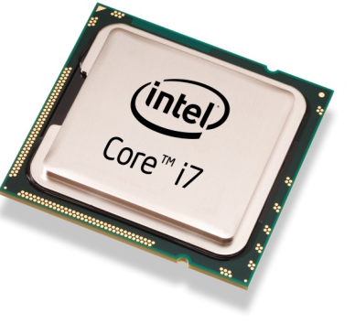
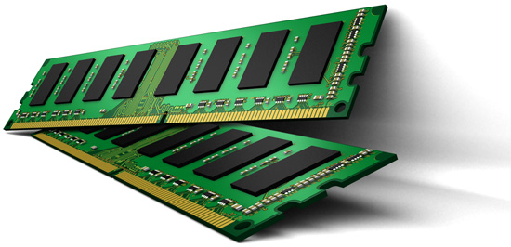
Parallelism: Demand vs. Supply
Demand
Supply
Out-of-order Execution
Multi-cores
Multiple
Banks
Prefetchers

Slide 39
Increasing Number of Banks?
Adding more banks → Replication of shared structures
Replication → Cost
How to improve available parallelism within DRAM?

Slide 40
Our Observation
Local to a subarray
1. Wordline enable
4. Charge restoration
2. Charge sharing
5. Wordline disable
3. Sense amplify
6. Restore sense-amps
Data Access
Time

Slide 41
Subarray-Level Parallelism
Row Decoder
Row Address
1
0
0
1
1
0
0
1
Time share
Replicate
Row Decoder
Row Address
Row Address
Column Read/Write

Slide 42
Subarray-Level Parallelism: Benefits
Two requests to different subarrays in same bank
Commodity DRAM
Data Access
Data Access
Time
Data Access
Data Access
Saved Time
Subarray-Level Parallelism

Slide 43
Results Summary
Commodity DRAM
Subarray-Level Parallelism
17%
19%

Slide 44
A Case for Exploiting Subarray-Level Parallelism (SALP) in DRAM
Yoongu Kim, Vivek Seshadri, Donghyuk Lee, Jamie Liu, Onur Mutlu
Published in the proceedings of 39th
International Symposium on Computer Architecture 2012

Slide 45
CSC 2224: Parallel Computer Architecture and Programming Main Memory Fundamentals
Prof. Gennady Pekhimenko
University of Toronto
Fall 2022
The content of this lecture is adapted from the slides of
Vivek Seshadri, Donghyuk Lee, Yoongu Kim,
and lectures of Onur Mutlu @ ETH and CMU

Slide 46
Review #5
Flipping Bits in Memory Without Accessing Them Yoongu Kim et al., ISCA 2014

Slide 47
Review: Memory Latency Lags Behind
128x
20x
1.3x
Memory latency remains almost constant

Slide 48
We Need A Paradigm Shift To …
Enable computation with minimal data movement
Compute where it makes sense (where data resides)
Make computing architectures more data-centric

Slide 49
Processing Inside Memory
Memory
Processor
Core
Database
Graphs
Media
Many questions … How do we design the:
compute-capable memory & controllers?
processor chip?
software and hardware interfaces?
system software and languages?
algorithms?
Cache
Query
Interconnect
Problem
Results
Algorithm
Program/Language
System Software
SW/HW Interface
Micro-architecture
Logic
Devices
Electrons

Slide 50
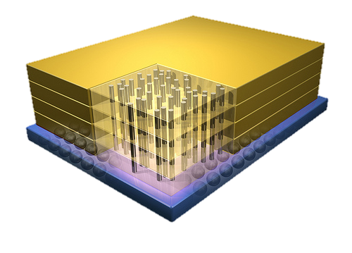
Why In-Memory Computation Today?
Dally, HiPEAC 2015
Push from Technology
DRAM Scaling at jeopardy
→ Controllers close to DRAM
→ Industry open to new memory architectures
Pull from Systems and Applications
Data access is a major system and application bottleneck
Systems are energy limited
Data movement much more energy-hungry than computation

Slide 51
Two Approaches to In-Memory Processing
1. Minimally change DRAM to enable simple yet powerful computation primitives
RowClone: Fast and Efficient In-DRAM Copy and Initialization of Bulk Data (Seshadri et al., MICRO 2013)
Fast Bulk Bitwise AND and OR in DRAM (Seshadri et al., IEEE CAL 2015)
Gather-Scatter DRAM: In-DRAM Address Translation to Improve the Spatial Locality of Non-unit Strided Accesses (Seshadri et al., MICRO 2015)
2. Exploit the control logic in 3D-stacked memory to enable more comprehensive computation near memory
PIM-Enabled Instructions: A Low-Overhead, Locality-Aware Processing-in-Memory Architecture (Ahn et al., ISCA 2015)
A Scalable Processing-in-Memory Accelerator for Parallel Graph Processing (Ahn et al., ISCA 2015)
Accelerating Pointer Chasing in 3D-Stacked Memory: Challenges, Mechanisms, Evaluation (Hsieh et al., ICCD 2016)

Slide 52
Approach 1: Minimally Changing DRAM
DRAM has great capability to perform bulk data movement and computation internally with small changes
Can exploit internal bandwidth to move data
Can exploit analog computation capability
…
Examples: RowClone, In-DRAM AND/OR, Gather/Scatter DRAM
RowClone: Fast and Efficient In-DRAM Copy and Initialization of Bulk Data (Seshadri et al., MICRO 2013)
Fast Bulk Bitwise AND and OR in DRAM (Seshadri et al., IEEE CAL 2015)
Gather-Scatter DRAM: In-DRAM Address Translation to Improve the Spatial Locality of Non-unit Strided Accesses (Seshadri et al., MICRO 2015)

Slide 53
Starting Simple: Data Copy and Initialization
Bulk Data Copy
src
dst
Bulk Data Initialization
dst
val

Slide 54
Bulk Data Copy and Initialization
Bulk Data Copy
src
dst
Bulk Data Initialization
dst
val

Slide 55
Bulk Data Copy and Initialization
memmove & memcpy: 5% cycles in Google’s datacenter [Kanev+ ISCA’15]
000000000000000
Zero initialization
(e.g., security)
Forking
Checkpointing
Many more
VM Cloning
Deduplication
Page Migration

Slide 56
Today’s Systems: Bulk Data Copy
1) High latency
Memory
3) Cache pollution
L3
CPU
L2
L1
MC
2) High bandwidth utilization
4) Unwanted data movement
1046ns, 3.6uJ (for 4KB page copy via DMA)

Slide 57
Future Systems: In-Memory Copy
3) No cache pollution
1) Low latency
Memory
L3
CPU
L2
L1
MC
2) Low bandwidth utilization
4) No unwanted data movement
1046ns, 3.6uJ
→ 90ns, 0.04uJ

Slide 58
RowClone: In-DRAM Row Copy
Idea: Two consecutive ACTivates
4 Kbytes
Negligible HW cost
Step 1: Activate row A
Step 2: Activate row B
Transfer row
DRAM subarray
Transfer
row
Row Buffer (4 Kbytes)
8 bits
Data Bus
Notes:
copy

Slide 59
RowClone: Intra-Subarray
V_{DD}
V_{DD}/2 + δ
V_{DD}
V_{DD}/2
V_{DD}/2 + δ
src
0
dst
0
Amplify the difference
Data gets copied
Sense Amplifier
(Row Buffer)
V_{DD}/2
0

Slide 60
RowClone: Intra-Subarray (II)
s
r
c
r
o
w
d
s
s
r
t
c
r
r
o
o
w
w
s
r
c
r
o
w
Row Buffer
1. Activate src row (copy data from src to row buffer)
2. Activate dst row (disconnect src from row buffer, connect dst – copy data from row buffer to dst)

Slide 61
RowClone: Inter-Bank
Chip I/O
Bank
Shared internal bus
Memory Channel
Overlap the latency of the read and the write
1.9X latency reduction, 3.2X energy reduction

Slide 62
Generalized RowClone
0.01% area cost
Inter Subarray Copy
(Use Inter-Bank Copy Twice)
Subarray
Chip I/O
Bank
Bank I/O
Memory Channel
Inter Bank Copy
(Pipelined
Internal RD/WR)
Intra Subarray
Copy (2 ACTs)

Slide 63
RowClone: Fast Row Initialization
0
0
0
0
0
0
0
0
0
0
0
0
Fix a row at Zero
(0.5% loss in capacity)

Slide 64
RowClone: Bulk Initialization
Initialization with arbitrary data
Initialize one row
Copy the data to other rows
Zero initialization (most common)
Reserve a row in each subarray (always zero)
Copy data from reserved row (FPM mode)
6.0X lower latency, 41.5X lower DRAM energy
0.2% loss in capacity

Slide 65
RowClone: Latency & Energy Benefits
74.4x
11.6x
41.5x
6.0x
1.9x
1.0x
3.2x
1.5x
Very low cost: 0.01% increase in die area

Slide 66
Copy and Initialization in Workloads

Slide 67
RowClone: Application Performance

Slide 68
End-to-End System Design
Application
How to communicate occurrences of bulk copy/initialization across layers?
Operating System
How to ensure cache coherence?
ISA
Microarchitecture
How to maximize latency and energy savings?
DRAM (RowClone)
How to handle data reuse?

Slide 69
Ambit In-Memory Accelerator for Bulk Bitwise Operations Using Commodity DRAM Technology
Vivek Seshadri
Donghyuk Lee, Thomas Mullins, Hasan Hassan, Amirali Boroumand, Jeremie Kim, Michael A. Kozuch, Onur Mutlu, Phillip B. Gibbons, Todd C. Mowry

Slide 70
Executive Summary
Problem: Bulk bitwise operations
present in many applications, e.g., databases, search filters
existing systems are memory bandwidth limited
Our Proposal: Ambit
perform bulk bitwise operations completely inside DRAM
bulk bitwise AND/OR: simultaneous activation of three rows
bulk bitwise NOT: inverters already in sense amplifiers
less than 1% area overhead over existing DRAM chips
Results compared to state-of-the-art baseline
average across seven bulk bitwise operations
32X performance improvement, 35X energy reduction
3X-7X performance for real-world data-intensive applications
Notes:
Talk about energy more
Explicitly state the performance improvement numbers
Range for throughput and energy?
Color more? Bulk AND/OR or NOT
Mechanism for NOT – fix the description. (use inverters already in sense amplifiers}?
Cost not coming out – mention the area cost

Slide 71
BitWeaving
(database queries)
Bitmap indices
(database indexing)
BitFunnel
(web search)
Bulk Bitwise Operations
Set operations
DNA
sequence mapping
Encryption algorithms
...
[1] Li and Patel, BitWeaving, SIGMOD 2013
[2] Goodwin+, BitFunnel, SIGIR 2017
Notes:
Add … (signify more applications)
Add references to some works (bitweaving, bitfunnel)

Slide 72
Today, DRAM is just a storage device!
DRAM
Write
Processor
(CPU, GPU, FPGA)
Channel
Read
Throughput of bulk bitwise operations limited by available memory bandwidth

Slide 73
Our Approach
DRAM
Processor
(CPU, GPU, FPGA or PiM)
Channel
Use analog operation of DRAM to perform bitwise operations completely inside memory!

Slide 74
Inside a DRAM Chip
…
…
…
…
2D Array
of DRAM Cells
…
…
Sense amplifiers
8KB

Slide 75
DRAM Cell Operation
wordline
capacitor
bitline
access transistor
Sense Amp
enable
bitline

Slide 76
DRAM Cell Operation
deviation in bitline voltage
raise wordline
wordline
1
0
½ V_{DD} + δ
½ V_{DD}
V_{DD}
capacitor
bitline
access transistor
connects cell to bitline
cell regains charge
cell loses charge to bitline
Sense Amp
1
0
enable sense amp
enable
bitline
½ V_{DD}
0

Slide 77
Triple-Row Activation: Majority Function
1
½ V_{DD} + δ
½ V_{DD}
0
V_{DD}
activate
all three rows
1
0
1
0
Sense Amp
1
0
enable sense amp

Slide 78
Bitwise AND/OR Using Triple-Row Activation
1
V_{DD}
A
1
B
1
C
Sense Amp
1

Slide 79
Bitwise AND/OR Using Triple-Row Activation
1
V_{DD}
A
Output = AB + BC + CA
= C (A OR B) +
~C (A AND B)
1
B
1
Control the value of C to perform bitwise OR or bitwise AND of A and B
C
38X improvement in raw throughput
44X reduction in energy consumption
for bulk bitwise AND/OR operations
Sense Amp
1

Slide 80
Bulk Bitwise AND/OR in DRAM
Statically reserve three designated rows t1, t2, and t3
Result = row A AND/OR row B
Copy data of row A to row t1
Copy data of row B to row t2
Initialize data of row t3 to 0/1
Activate rows t1/t2/t3 simultaneously
Copy data of row t1/t2/t3 to Result row
Copy data of row A to row t1
Copy data of row B to row t2
Initialize data of row t3 to 0/1
Activate rows t1/t2/t3 simultaneously
Copy data of row t1/t2/t3 to Result row
MICRO 2013
Notes:
* each copy operation takes only 80ns

Slide 81
Bulk Bitwise AND/OR in DRAM
Statically reserve three designated rows t1, t2, and t3
Result = row A AND/OR row B
Copy RowClone data of row A to row t1
Copy RowClone data of row B to row t2
Initialize RowClone data of row t3 to 0/1
Activate rows t1/t2/t3 simultaneously
Copy RowClone data of row t1/t2/t3 to Result row
Copy data of row A to row t1
Copy data of row B to row t2
Initialize data of row t3 to 0/1
Activate rows t1/t2/t3 simultaneously
Copy data of row t1/t2/t3 to Result row
Use RowClone to perform copy and initialization operations completely in DRAM!
Notes:
Replace copies with rowclone once it is mentioned
Tie back to the concerns.
Reiterate speedup numbers
strike copy and make it rowclone

Slide 82
Negation Using the Sense Amplifier
Can we copy the negated value from bitline to a DRAM cell?
bitline
Sense Amp
enable
bitline
Notes:
Mark the enable signal to the sense amplifier
Before introducing the dual contact cell, state the key idea

Slide 83
Negation Using the Sense Amplifier
Dual Contact Cell
Regular wordline
Negation wordline
bitline
Sense Amp
enable
bitline
Notes:
Mark the enable signal to the sense amplifier
Before introducing the dual contact cell, state the key idea

Slide 84
Negation Using the Sense Amplifier
½ V_{DD} + δ
½ V_{DD}
activate source
V_{DD}
source
activate
negation wordline
bitline
Sense Amp
enable sense amp
½ V_{DD}
0
bitline
Notes:
Provide the result for NOT
Present all the results after this slide?

Slide 85
Ambit vs. DDR3: Performance and Energy
32X
35X

Slide 86
Integrating Ambit with the System
PCIe device
Similar to other accelerators (e.g., GPU)
System memory bus
Ambit uses the same DRAM command/address interface
Pros and cons discussed in paper
(Section 5.4)
Notes:
Make it simpler
Two approaches.

Slide 87
Real-world Applications
Methodology (Gem5 simulator)
Processor: x86, 4 GHz, out-of-order, 64-entry instruction queue
L1 cache: 32 KB D-cache and 32 KB I-cache, LRU policy
L2 cache: 2 MB, LRU policy
Memory controller: FR-FCFS, 8 KB row size
Main memory: DDR4-2400, 1 channel, 1 rank, 8 bank
Workloads
Database bitmap indices
BitWeaving –column scans using bulk bitwise operations
Set operations – comparing bitvectors with red-black trees
Notes:
Add color
Fix workloads – add set operation workload as well

Slide 88
Bitmap Indices: Performance
6.6X
6.2X
6.3X
5.7X
6.1X
5.4X
Consistent reduction in execution time. 6X on average
Notes:
Add color
Remove “week” and “users”

Slide 89
Speedup offered by Ambit for BitWeaving
select count(*) where c1 < field < c2
Number of rows in the database table
12X
Notes:
Reference bitweaving again
Add color
Fix the tag

Slide 90
Review #5
Flipping Bits in Memory Without Accessing Them Yoongu Kim et al., ISCA 2014

Slide 91
CSC 2224: Parallel Computer Architecture and Programming Advanced Memory
Prof. Gennady Pekhimenko
University of Toronto
Fall 2022
The content of this lecture is adapted from the slides of
Vivek Seshadri, Yoongu Kim,
and lectures of Onur Mutlu @ ETH and CMU

